Slide 1
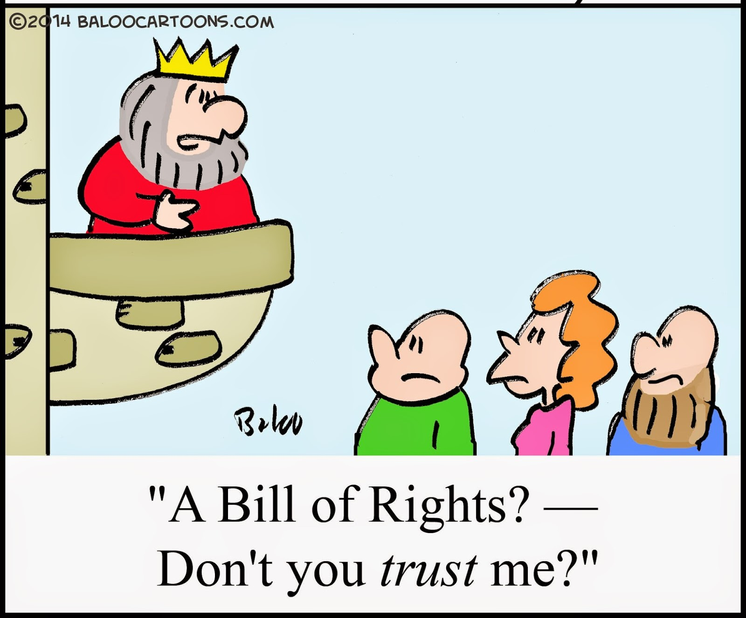
An audience with
Queen Internet
A „Bill of digital
Rights and
Responsibilities“
Klaus Stoll, CEO
Internet Integrity
Task Force

Slide 2
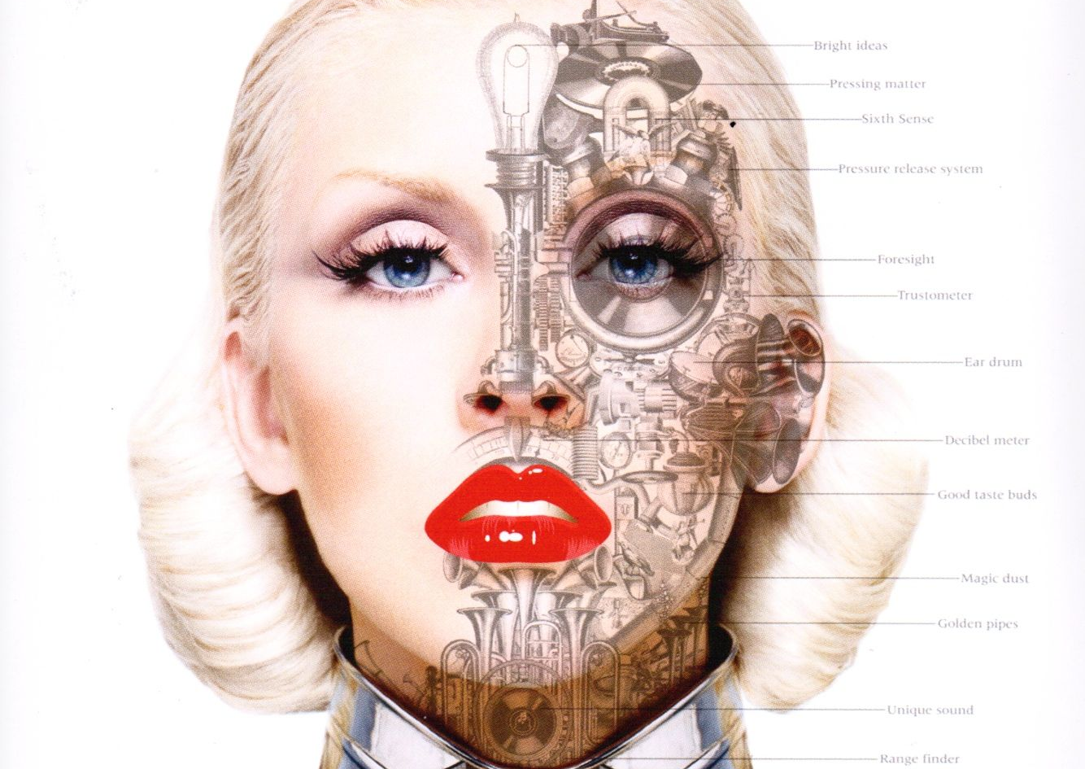
Duality of our
existence today
We live our life's in the literal world and in virtual cyberspace.
We are dual citizens of our country and cyberspace.

Slide 3
We are torn between…
…the increasing impact
of digital technologies…
…and our lack of
control over them.

Slide 4
Cyberspace is lacking an
effective global system
of governance.
Sovereignty ends at the border.
Digital governance is dominated by special interests, not the common good.

Slide 5
Lacking effective national and global digital governance, we don’t know how to exercise our rights and responsibilities in Cyberspace.

Slide 6
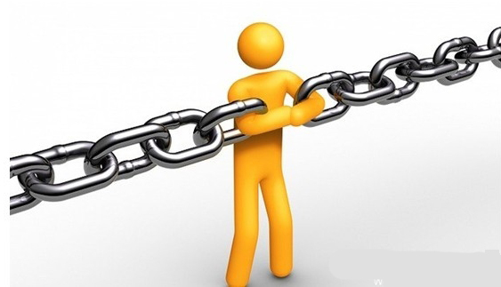
The “Missing link”:
A digital Bill of Rights!
…but we can say with
certainty that we need a
digital Bill of Rights to
protect those subject to
digital technologies against governmental and private
sector,arbitrariness and
despotism.
We cannot answer many
questions regarding the
governance of cyberspace, …

Slide 7
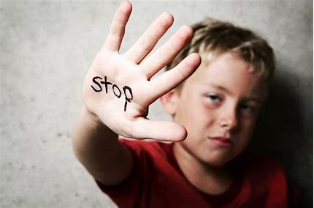
The role of a Bill of Rights is to remind those with power to pay attention to the fundamental rights of those that are subject to that power.

Slide 8
The key question:
What core values inform a digital Bill of Rights?

Slide 9
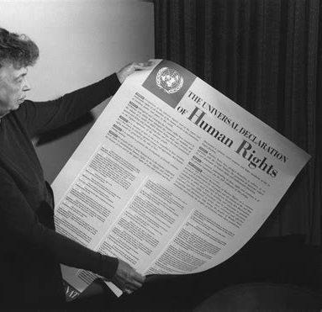
The UDHR represents the fundamental human values that are common to us all.
Trust exists where the fundamental human rights are respected.
The UDHR represents the Constitution of our living together.
Without respect for the fundamental human rights there is no true economic development and sustainability.

Slide 10
What happens when we extent and apply our fundamental human rights in Cyberspace?

Slide 11
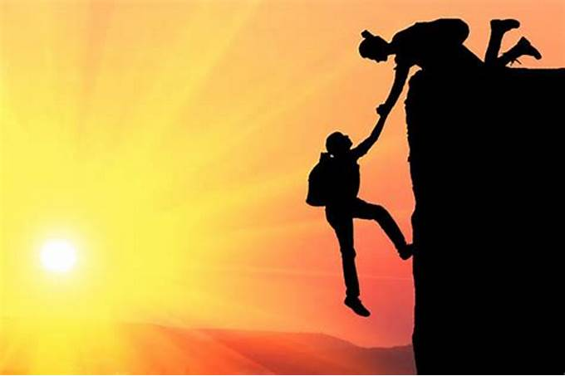
Example 1: Restoring Trust
Restoring trust cannot be solved through engineering but requires values.
A Bill shifts the viewpoint from a limited and self-interest driven perspective to a common human rights based. In so doing it restores trust.
Trust is the
foundation
of economic
and social
stability and
development
in cyberspace.

Slide 12
Example 2: Defining Roles
Digital users are able to exercise our rights and responsibilities in Cyberspace.
Governments will be able to accept that they have to share sovereignty in cyberspace.
Private sector will be able to accept that innovation comes with responsibilities. Responsibilities become the source of economic prosperity in a new “digital economy of trust”

Slide 13
Example 3: AI
Machines don’t become “the better people”. The real issue is how to build in algorithmic routines that observe the codified rights and responsibilities of a digital Bill of Rights.

Slide 14
Example 4: Creating a foundation to weigh options
Freedom of expression gains a context in which it can be exercised with responsibly.
Fake news and manipulation are checked.

Slide 15
The Bills can produce an initial period of healing and restoration of trust, resulting in growth and wealth without exploitation and suppression.
People will come to a point where they feel that “We hold these truths to be self-evident” regarding the rights and responsibilities of their digital citizenship. Then the time will have come to establishment an Internet Governance that reflects and protects peoples’ human rights.
To reach this stage the key will be stakeholder engagement and dialogue, to develop a digital Bill of Rights together with ongoing awareness and capacity building on all levels and all sectors.
The Bills enables a period of healing and restoration of trust.
To transform the values of the Bill of Rights into experienced reality, requires ongoing awareness and capacity building, stakeholder engagement, integrity-based business models and legitimate digital governmental structures.

Slide 16
For further information visit:
iitf.online
Contact:
info@iitf.online

